Slide 1


SAP S/4HANA CDS, SAC Training Day 3
Anubhav Oberoy

Slide 2

Agenda – Day 3
CDS perspective
VDM – Virtual Data Model
Arrangements for VDM objects
Analytic use case
CDS Security and Steps for securing data Understanding Facts and Dimensions
Analytic use case
S/4HANA Embedded Analytics – Query browser
CDS Security and Steps for securing data
--break
Introduction to AMDP
AMDP Scenario
Consume AMDP in ABAP program
Notes:
https://unsplash.com/photos/CPs2X8JYmS8

Slide 3

Working with CDS Examples
Working with CDS entity and CDS with Expression Language (DEL)
View on View Concept
In a real time, environment, we do not want to clutter all our code inside single CDS view. Because we want to achieve modularization. In View-on-View concept, we will consume one view on top of another view. This way we can create multiple reusable views and consume them in upper views.
Adding Aggregation to CDS entities
Joins using CDS entities
Concept of Association
Associations are the relationships between entities and views. It is used to avoid joins, because joins are bad for performance, associations are loose coupling between our data. The data will fetched on-demand when it requested. The join will be performed only when needed, hence saves lots of time.
There are 2 types of association
Ad-hoc association – just exact join
Exposed association – lose coupling

Slide 4

























Slide 5
































Slide 6





























Slide 7

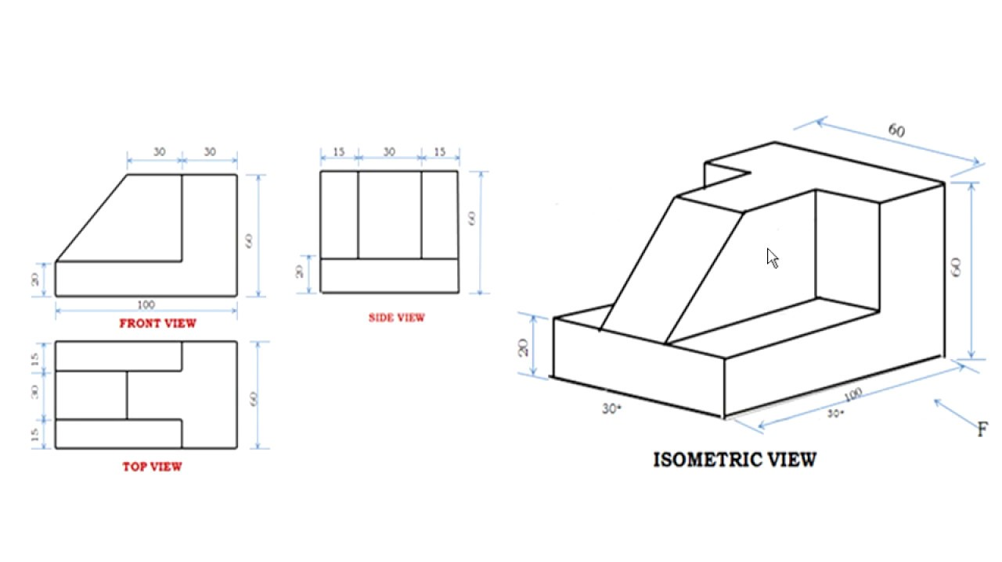
Why someone fails to learn CDS from google?
< >
9
www.anubhavtrainings.com

Slide 8

CDS Perspective
ABAP Program
@Odata.publish
Fiori App
@Analytics
@AnalyticDetails
CDS View
Data Analytics
@Odata.publish
S/4HANA embedded Analytics
@Analytics
@AnalyticDetails
Integration API
@Odata.publish
@ObjectModel
RAP/BOPF
9
www.anubhavtrainings.com

Slide 9
VDM – Virtual data modeling
Is a gold standard and best practice to build CDS views in S/4HANA projects. This standard is adopted already by SAP so by learning this you will also be able to understand standard CDS view structures.
When we join a project, we would not need any KT from anyone if project follow VDM
In absence of a colleague, we will be able to manage the development and understand purpose
When SAP deliver standard CDS views, they do not share mobile no. of their SAP labs developer
It allows great modularization and the best practices for a scalable project design
Interface views
Private
Consumption
Starts with P_
@VDM.private: true
These are the views built by SAP and reused by SAP itself.
As a developer we can use private views to build our views but we must not?
SAP do not guarantee the stable contract
Basic
Composite
Starts with C_, @VDM.viewType : #COMPOSITION
They are used for final consumption for our use case e.g. Fiori App, Analytics, Integration etc.
Annotations related to final UI and tool consumption
In Data analytics we create with annotation @Analytic.query: true
Which creates a BeX query in SAP S/4HANA.
Starts with I_, @VDM.viewType : #BASIC, #COMPOSITE
We can certainly use them in our projects, view on view because contract remains stable RoR
Basic views are always used to ready either Pure Master or Pure transaction
If we want combination of master and transaction data we can go with composite views
A composite view can act like a #CUBE view for data analytics. Usually these views are used to aggregate data with @DefaultAggregation annotation
We can build interface views on top of private(our) or other interface views
9
www.anubhavtrainings.com

Slide 10
Arrangement
Fiori App
Analytic Tools
Third Party
API Consumer
Consumption views
Consumption views
@Analytic.query
Interface composite views
Interface Composite views
#CUBE
Basic interface views
Basic interface views
Basic interface views
Private views
Private views
DB Tables
DB Tables
DB Tables
DB Tables
DB Tables
DB Tables
DB Tables
9
www.anubhavtrainings.com

Slide 11
Use Case
We are working as S/4HANA consultant in a company, the company have sales stored in the EPM data table. We would like to build a dashboard to help company projecting following requirement
Total sales per Country – total gross amount, max net amount, average tax amount
Total Sales per Currency
Total Sales per Product
Total Sales per Customer
9
www.anubhavtrainings.com

Slide 12
Use Case
We have business partner data of multiple counties displayed on the BUPA view. We want to secure this data, we want also row level security. That a manager who is working in US can only see USA customers hence a manager in Japan must only see the Japanese customers.
User
CDS DCL
Auth Class
1..*
Role
Auth Objects
Profile
1..*
Auth Fields
value
9
www.anubhavtrainings.com

Slide 13
Steps
Transaction code SU20 and define an authority field since we want to control permissions based on Country we will use the field as Country. - ZCTRY_APR
Go to transaction SU21 and create a authority class (ZBUP) and authorization object (ZAPR_BUPA).
We add the authority field to the object and a new filed ACTVT with type as 03
Open tcode pfcg and create a new role - ZAPR_BR_CDS_BUPA
9
www.anubhavtrainings.com

Slide 14
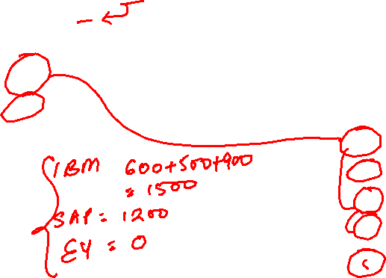
Introduction to Facts and Dimension
Customer Master data
Dimension
Product Master data
Dimension
CustId | Name
A | IBM
B | SAP
C | EY
ProdId | Name
P1 | iPhone
P2 | WebCam
P3 | PC
Transactional data – Facts
Measure – KPI – Key performance indicator
SOID | CustID | ProdId | Amount | Country
100001 | A | P1 | 600 | IN
100002 | B | P1 | 800 | US
100003 | A | P2 | 500 | US
100004 | A | P3 | 900 | IN
100005 | B | P2 | 400 | US
Total sales in sales dept.
Country | Name
IN | India
US | United S
JP | Japan
Time
9
www.anubhavtrainings.com

Slide 15
Use Case
We are working as S/4HANA consultant in a company, the company have sales stored in the EPM data table. We would like to build a dashboard to help company projecting following requirement
Total sales per Country – total gross amount, max net amount, average tax amount
Total Sales per Currency
Total Sales per Product
Total Sales per Customer
9
www.anubhavtrainings.com

Slide 16
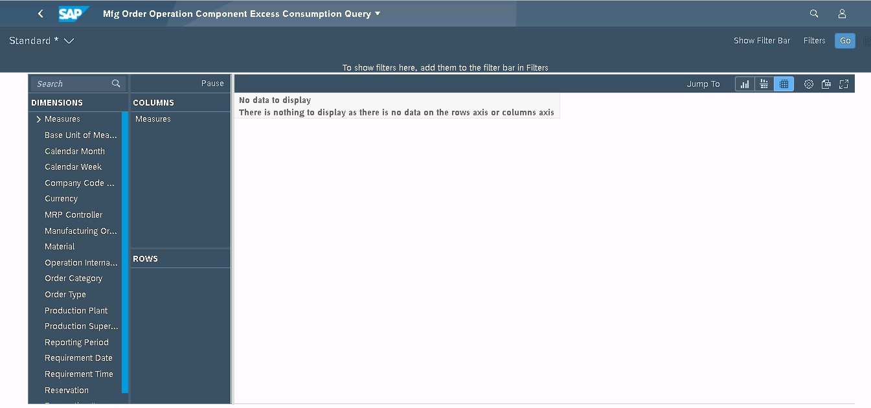
Query Browser
The Query Browser is an SAP Fiori application that you use to quickly and easily search for, browse, and tag the analytical queries. This application displays all the authorized analytical queries and customer queries to which the user has access. To launch the application, choose Query Browser from the Query Browser catalog. By default, the content views are pre-organized by the view name.
https://122.162.240.164:44330/sap/bc/ui2/flp#Shell-home

Slide 17
Use Case
We have business partner data of multiple counties displayed on the BUPA view. We want to secure this data, we want also row level security. That a manager who is working in US can only see USA customers hence a manager in Japan must only see the Japanese customers.
User
CDS DCL
Auth Class
1..*
Role
Auth Objects
Profile
1..*
Auth Fields
value
9
www.anubhavtrainings.com

Slide 18
Steps
Transaction code SU20 and define an authority field since we want to control permissions based on Country we will use the field as Country. - ZCTRY_APR
Go to transaction SU21 and create a authority class (ZBUP) and authorization object (ZAPR_BUPA).
We add the authority field to the object and a new filed ACTVT with type as 03
Open tcode pfcg and create a new role - ZAPR_BR_CDS_BUPA
9
www.anubhavtrainings.com

Slide 19
SQL Script Rules
It is not case-sensitive
Every statement ends with semi-column ( ; )
If we create a variable and do not assign any value to it, a null gets assigned and any operation with NULL produce a null
When we create a variable and assign a value we can do it directly with variable name
When we use a variable inside an operation we use the value of (:)
We create variables using DECLARE statement in SQL Script (in ABAP we use data)
In SQL Script = is a comparison operator but := is the assignment operator.
DECLARE x integer;
DECLARE y integer;
DECLARE z integer;
x := 10;
Y := 20;
Z := :x + :y;
In SQL Script everything evolves around SQL so even we need to print data we use SELECT var FROM dummy;
DUMMY is a dummy table provided by SAP to just print data in output
Data types for creating variables
Number – integer, BIGINT, Decimal, TINYINT
Char – CHAR, VARCHAR, NVARCHAR
Special – BLOB, CLOB
Date – DATE, TIMESTAMP, DATETIME
9
www.anubhavtrainings.com

Slide 20


AMDP – ABAP Managed Data Procedure
AMDP is an object created in ABAP system and at runtime it generates the procedure in HANA system hence we achieve code to data paradigm. It is one of the best technique to push down logic to the database. There is no need to login to HANA database anymore using HANA Studio as we can directly write SQL Script logic in ABAP system. Internally it contains SQL Script logic.
An AMDP is a ABAP class which contains SQL Script logic mutated by using an interface if_amdp_marker_hdb
An AMDP is a static method inside of a class
The class can contain both ABAP and AMDP method but we cannot merge abap code
The class gets capability to do syntax check for sql script code
The AMDP method cannot have changing and return parameter
We have passed all values pass by value, if you plan to use tables in AMDP you must define them with using clause
We cannot use complex data types like deep structures
We have to also use a special syntax for defining AMDP method
An AMDP is managed by ABAP system, hence it is sufficed to use ABAP transport to send to Q and P
When we activate AMDP nothing happens, when your call the AMDP that’s when the procedure gets created in HANA
Peter parker
Spiderman
Mutation
IF_AMDP_MARKER_HDB
9
www.anubhavtrainings.com

Slide 21

OIA Scenario – Based on EPM Model
Open Item Analysis Scenario
Mr. Jems is 65-year-old men, working in ITeIO company since last 25 years as an account receivable accountant. He drives Audi A8 and lives in downtown in his own house near the lake. He loves reading books and do gardening.
Who is an Account Receivable Accountant?
Cash has a very important role for the success of the business. It is in the best interest of a company to collect the pending dues from their customers on time. By putting this cash back into the system company can execute their expansion plans and perform better for profitability in the future. An accountant’s job is to look into the system and find out all the unpaid invoices. He typically comes into the office and look for invoices are pending since long time and exceeds a particular threshold. Classify these invoices and perform dunning (contact customers).
9
www.anubhavtrainings.com

Slide 22
Takt Plan
Store the threshold levels inside a customizing table for the user – ZDP_CUST
How long the invoices are due on average days basis
Invoices which are unpaid by the customers – SNWD_SO_INV_HEAD where Payment_status = ‘’
Calculate the average no. of days since when every invoice is pending for each customer (Today – When was changed)
We will calculate average = Total (How many days all invoices are due) / Count (Count of invoices)
e.g. total 4 invoices due as 10,20,30,5 = 10+20+30+5 / 4
Join this with the customer master SNWD_BPA
3. Calculate the total due amount in common currency
1. Find the open invoices which are due SNWD_SO_INV_HEAD , Payment_Status = ‘’
2. get the items for each due invoice and its amount with currency code – SNWD_SO_INV_ITEM, CONVER_TO_CURRENCY
3. Convert the amount to a common currency which we can read from the Customizing table
4. Total due amount and join with Customer Data
4. Compare the open days and open amount with the threshold, if yes, we will tag the customer.
Takt1
Takt2
9
www.anubhavtrainings.com

Slide 23
More Questions
How to debug an AMDP
https://www.youtube.com/watch?v=fpXoTqHLeSo
How to call one AMDP inside another AMDP
https://youtu.be/r2LsDROiJ90
Can you show one more real time scenario in AMDP like FOR ALL ENTRIES in ABAP
https://youtu.be/Tm1RFOt0KMY
https://youtu.be/dIMPMNlT7jQ
How to do performance analysis on AMDP
https://youtu.be/KLgTI1J5d3E
Can we add AMDP method and also normal ABAP method in same class
https://youtu.be/1JkX-XuSeVE
How to implement selection-options with AMDP
https://youtu.be/hbtnWi032Z8
9
www.anubhavtrainings.com

Slide 24
Title
Text

Slide 25
Title
Text

Slide 26

Questions?

Slide 27

Thank you
Anubhav.abap@gmail.com
contact@anubhavtrainings.com
+91 84484 54549
www.anubhavtrainings.com

